Slide 1
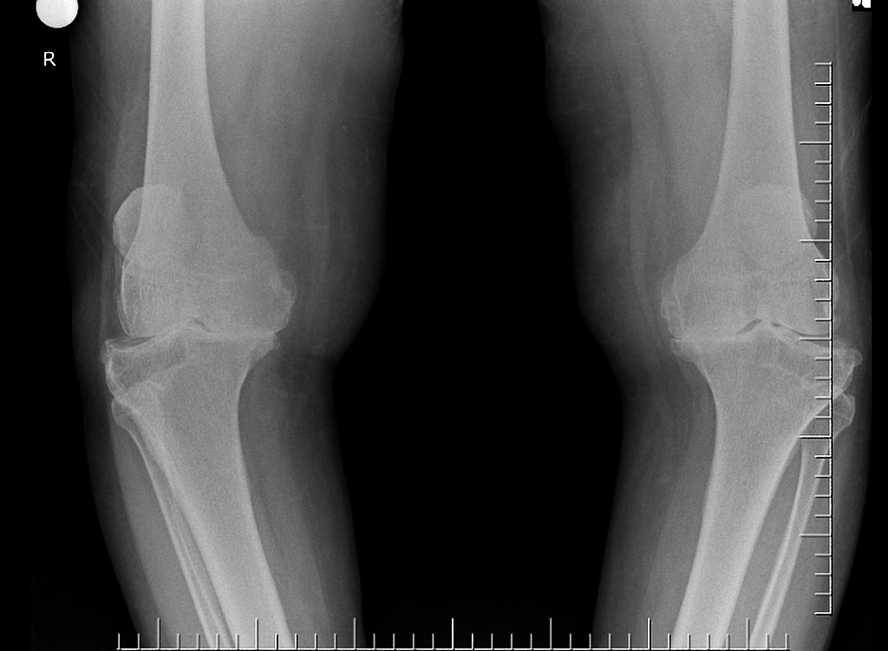

Limited Personal Protective Equipment (PPE) Supply During COVID-19 Pandemic: Impact on Elective Surgery
Supervisors: Dr. Antoine Saure, Dr. Wojtek Michalowski
Stephen Kingwell, BScPT, MD, FRCSC
Orthopaedic Spine Surgeon, Ottawa Hospital
Assistant Professor, University of Ottawa

Slide 2
Background

Slide 3
Background: Cessation of Scheduled Surgical Services
Concern that COVID-19 would overwhelm hospital critical care bed and ventilator capacity in addition to personal protective equipment (PPE) supply led to a dramatic pre-emptive reduction or cessation in many surgical services.
Continuation of “urgent” or “unscheduled” surgical activity
Cancer, cardiac, irreversible deterioration in 7 days

Slide 4
Background

Slide 5
Background

Slide 6
Background Resumption of scheduled surgery-Ethics, expert opinion, directives
Stability of COVID-19 cases
85% hospital capacity
Critical care capacity
PPE supply

Slide 7
Knapsack Problem
Surgical, hospital and PPE resources are limited, and the negative impact of surgical delays may vary widely among patients and diseases, the allocation of limited surgical resources represents a very complex problem
Combinatorial optimization problem in operations research
where given a set of items (surgical services conducted during specific period of time), each with a set of characteristics (usage of PPE items and other limited elective surgery resources), one needs to determine the number of each item to include in a collection (portfolio of surgical services) so that the resulting allocation is the best in terms of benefits (for example, societal value or urgency of the selected elective surgeries) subject to the availability of resources (available PPEs).

Slide 8
Knapsack Problem
The goal of this study was to apply the KP approach to the problem of determining the optimal scheduling of orthopedic surgical services considering the limitation of PPEs and outlining how the model complexity can be increased to create “real world” applicability by incorporating additional items such as the effect of surgical delays on patient outcomes.

Slide 9
Methods-Study Setting
Tertiary academic hospital in Canada.
The Division of Orthopedic Surgery has a logistical separation into 8 clinical practice units (CPU’s) for quality improvement, research and educational purposes including scheduling and patient data collection. The CPU’s include foot and ankle, hand and wrist, hip and knee reconstruction, hip preservation, knee preservation and sports medicine, oncology, shoulder and elbow, and spine.

Slide 10
Methods-PPE utilization
TOH supply
This is potentially modifiable depending on need and supply chains
TOH PPE use
Variable and generally not modifiable
Is there adequate PPE left to safely start elective surgery
TOH inpatient
TOH ambulatory clinics
TOH Brewer assessment center
TOH emergent/urgent surgery
?
Unit is “OR days”
PPE supply
TOH elective surgery activity
PPE items
If we show adequate PPE remaining given non-negotiable demands then we can determine how much elective capacity (10%, 50%, 75% etc..?)
Masks: N95, surgical, non-surgical
Gowns: surgical, non-surgical
Gloves: surgical, non-surgical
Face shields

Slide 11
Methods-PPE Utilization
TOH PPE Dashboard

Slide 12
Methods-PPE Utilization
Work with nurse manager
Staff
Nursing, surgeon, assistant, anesthesia, radiation technician, housecleaning, patient care assistant
Determine staff movements based on scheduling (nursing)
Case length
Short (1-2 hours), medium (2-4 hours), long (4-8 hours)

Slide 13
Methods-PPE utilization
Our knapsack model will use CPU’s within orthopedic surgery as opposed to surgical divisions

Slide 14
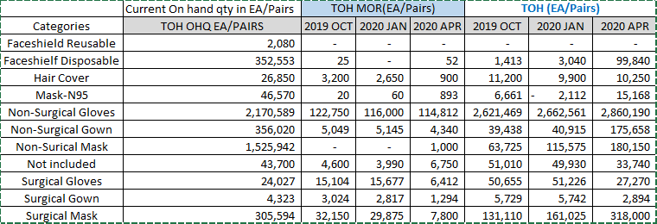
Methods-PPE utilization

Slide 15
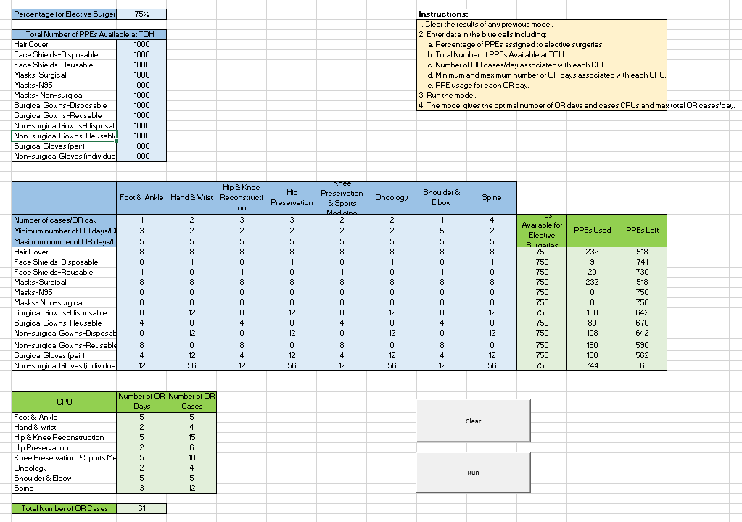
Results

